Slide 1

Private Key Sharing for Threshold Signatures in Bitcoin: Shamir’s Scheme and a Preliminary Study on Level-1 Homomorphic Encryption Applications
Department of Information and Computer Science
Course: SEC 595 Sp. Topics in Info. Assu & Sec
Juan Pablo Crespo Vargas
ID 202393610

Slide 2
Index
Introduction
Motivation: Bitcoin Problem
Digital Signature Algorithm in Eliptic Curve
A brief demostration
Proposal: Threshold Signature
Considerations and protocol
Experiments and Results
Conclusions

Slide 3
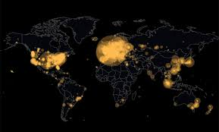
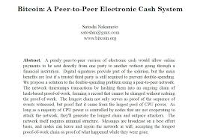
Introduction

Slide 4
Bitcoin Base
Bitcoin is based on different technologies, but primarly
A hash function: SHA256 A cryptographic function that acts as a digital fingerprint
A Protocol of Consensus PoW The foundation of the network’s security to maintain a common ledger
A cryptographic Digital Signature ECDSA it is the foundation of absolute private property

Slide 5
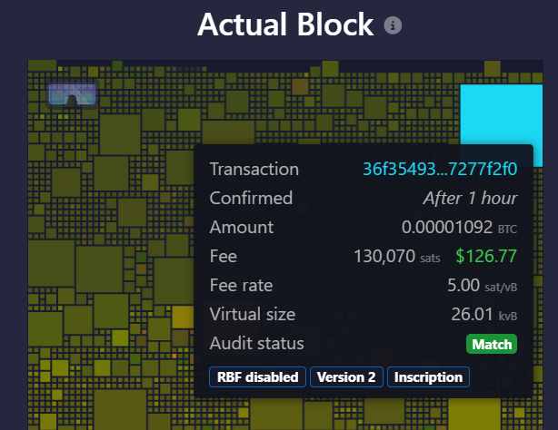
Motivation
The first principle: Not your keys, not your Bitcoins.
Single Point of Failure:
If you lost your private key, you lost all of your Bitcoins
A Solution:
Multisign Scheme, you can create a special UTXO (coins) with a Lock Script, you need a multiple signs of multiple Keys t/n e.g. 3/5 are needed to create a valid sign.
A New Problem:
As the need to use the network grows, the space in a block becomes more expensive. Having many signatures takes up a lot of space.

Slide 6
Motivation
New efficient ways to sign a UTXO are needed, avoiding reliance on a single point of failure.
New Idea: A Threshold Signature. What is the difference with multisignature:
In multisignature, each participant has their own signature, which they must provide to authorize a transaction with a minimum threshold of t.
In threshold signature, a threshold of t+1 participants combine their parts of a secret key to generate a single valid signature, without anyone knowing the private key.

Slide 7
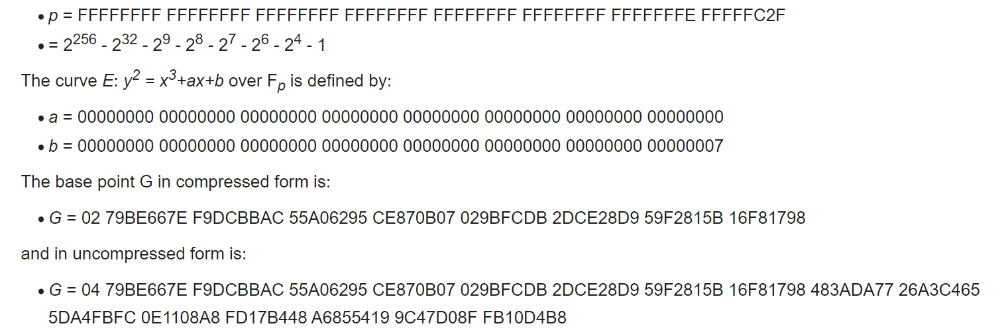
ECDSA
Use a NIST standard: SECp256K1

Slide 8
ECDSA - Demo
Please check test_ecdsa.ipynb

Slide 9
Proposal Threshold
1. It requires only n ≥ t + 1 servers.
2. The protocol requires only a constant number of rounds.
3. The computation time for each player is constant.
4. Players require only a constant amount of storage.

Slide 10
Proposal Threshold
Communication: - P2P between P1,...,Pn Participants
- Broadcast Channel
Adversary:
– honest-but-curious: the corrupted players follow the protocol but try to learn
information about secret values;
– malicious: corrupted players to divert from the specified protocol in any (possibly
malicious) way. Ideal Environment with a Trusted Coordinator

Slide 11
Proposal Threshold
Communication: - P2P between P1,...,Pn Participants
- Broadcast Channel
Adversary:
– honest-but-curious: the corrupted players follow the protocol but try to learn
information about secret values;
– malicious: corrupted players to divert from the specified protocol in any (possibly
malicious) way. Ideal Environment with a Trusted Coordinator

Slide 12
Considerations and protocol
n Number of Participants.
t The number of threshold
Commitments and ZKproof In this project has a first approximation we don’t consider this part, assuming the all participant are honestly.
First Step: Creation of a Private Key: Every Participant create a random value. A Coordinator create a pk,sk of a Paillier Scheme, and send to a Public Channel Every Participant encrypt their part and send it in the Public Channel A Coordinator run a Additive Homomorphic (and verify the same calculation with all participant). A Coordinator decrypt the result and create a Shamir Secret Sharing, and send the secret to every participant through de p2p channel. A Coordinator publish the public Key in the public Channel

Slide 13
Considerations and protocol
Up to this point, it is necessary to reconsider potential issues:
In a real-world environment, decryption and the creation of the Shamir scheme must be performed by each participant, justifying their commitments and proving their correct data without revealing their secret (zk-proof).
Second Part: Signature. - Every t Participant create a random k and share it and their secret with the coordinator through p2p channel.
- The coordinator create a total K with the homomorphic addition of their parts and sign the message provided reconstructing the private key using interpolation in Shamir's scheme and share this in the public Channel
Considerations: It is crucial that K is not known by any participant nor reused, as it can be used to reconstruct the private key. This is avoided with a trusted coordinator.In a real-world environment, this process must be carried out by each participant.

Slide 14
Experiments and Results
Please check test_threshold.ipynb

Slide 15
Conclusions
Threshold signatures provide an efficient and secure alternative to multisignature schemes by generating a single valid signature while maintaining decentralization and privacy.
The use of Shamir's scheme and zk-proofs ensures that private keys remain confidential and resistant to compromise.
In real-world scenarios, careful implementation is required to prevent reuse of shared keys and ensure trustless coordination among participants.
This approach significantly reduces block space usage, addressing scalability concerns in the Bitcoin network.
Further research and experimentation are necessary to optimize protocols and evaluate their robustness in practical applications.

Slide 16
References.
Gennaro, R., Goldfeder, S., & Narayanan, A. (2016). Threshold-optimal DSA/ECDSA signatures and an application to bitcoin wallet security. In Applied Cryptography and Network Security: 14th International Conference, ACNS 2016, Guildford, UK, June 19-22, 2016. Proceedings 14 (pp. 156-174). Springer International Publishing.
Boneh, D., Gennaro, R., & Goldfeder, S. (2017, September). Using level-1 homomorphic encryption to improve threshold DSA signatures for bitcoin wallet security. In International Conference on Cryptology and Information Security in Latin America (pp. 352-377). Cham: Springer International Publishing.
Jia, L., Chen, X., Liu, L., Wang, X., Xiao, K., & Xu, G. (2023). Blockchain data secure sharing protocol based on threshold Paillier algorithm. High-Confidence Computing, 3(4), 100132.
Hamidi, A., & Ghodosi, H. (2022, December). Efficient Distributed Keys Generation of Threshold Paillier Cryptosystem. In International Conference on Information Technology and Communications Security (pp. 117-132). Cham: Springer Nature Switzerland.

Slide 17

Thank you for your attention.

